Slide 1
Developers Community & Auto UML generator
Presented by Hazar Gul Nazari (1414322)
Supervisor: Prof. Isa Fathy

Slide 2
Aim of Project
Aim #1.
A unique platform for developers to communicate
Aim #2.
An easy way of generating UML from Source code

Slide 3
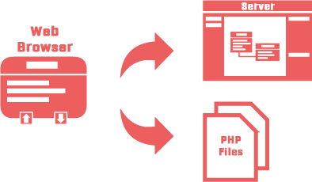
Problem Definition
There’s no such online tool to generate UML diagram from the source code (Reversed Engineering)
A unique platform for developers to communicate and share ideas and their UML diagram

Slide 4
Project Scope
The scope of this project is to create a web application which is a complete platform for developers to communicate, share their ideas and their generated UML diagram by uploading their PHP source code. Developers can create a new community for a language of framework, for example, a community for PHP developers or a community for jQuery developers where they can shares ideas about that specific topic.

Slide 5
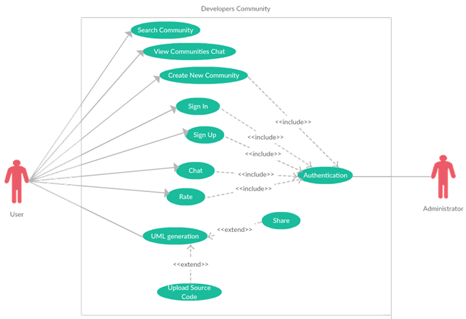
Use Case Diagram

Slide 6
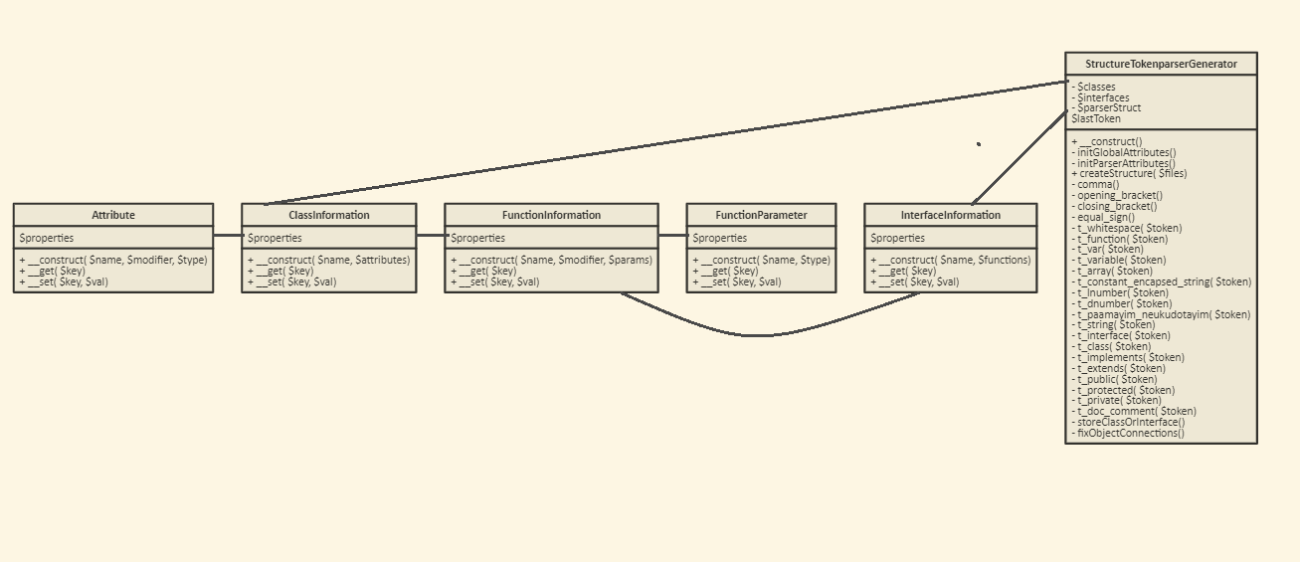
Class Diagram for PHP Syntax Parser

Slide 7
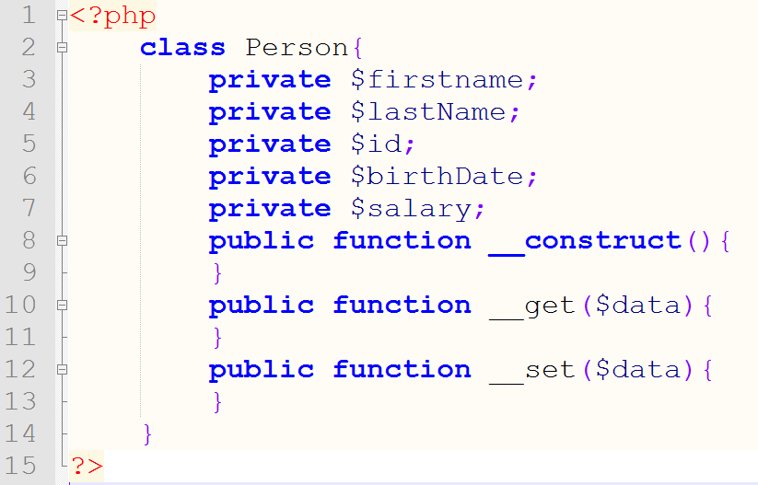
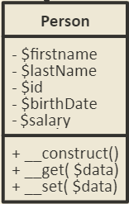
Solution for UML parsing

Slide 8
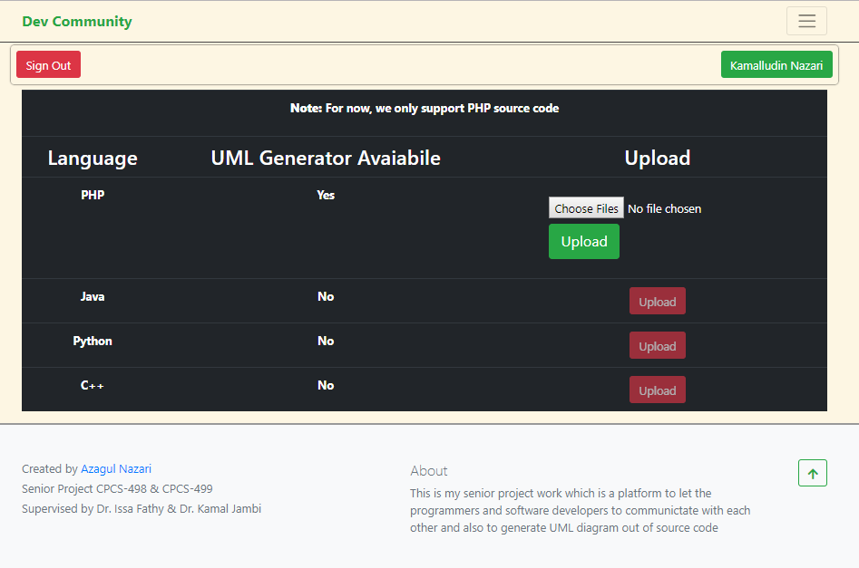
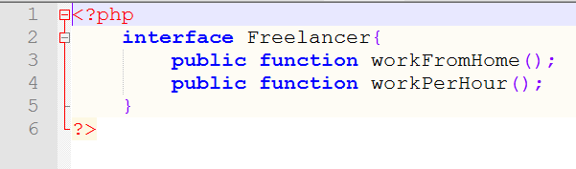
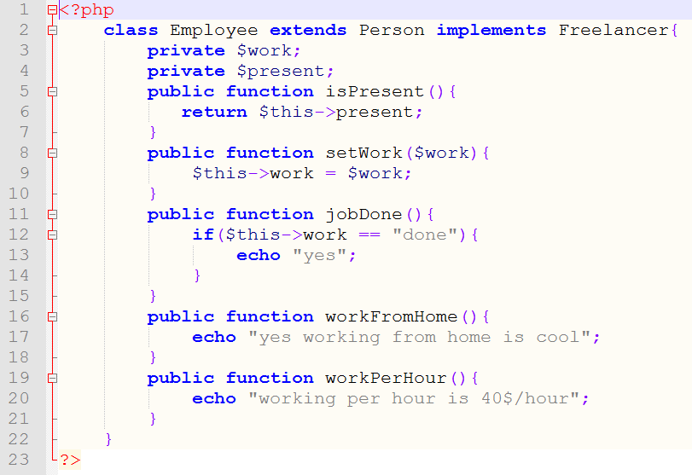
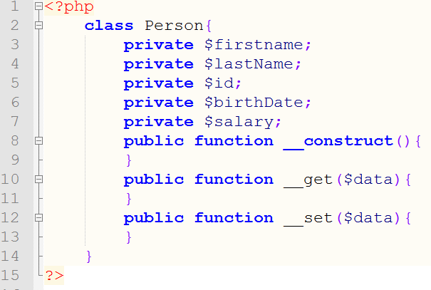
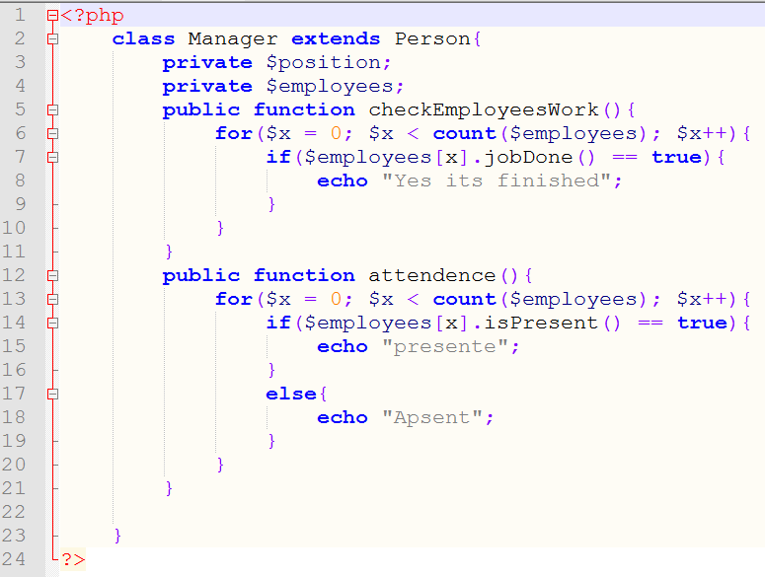

Slide 9
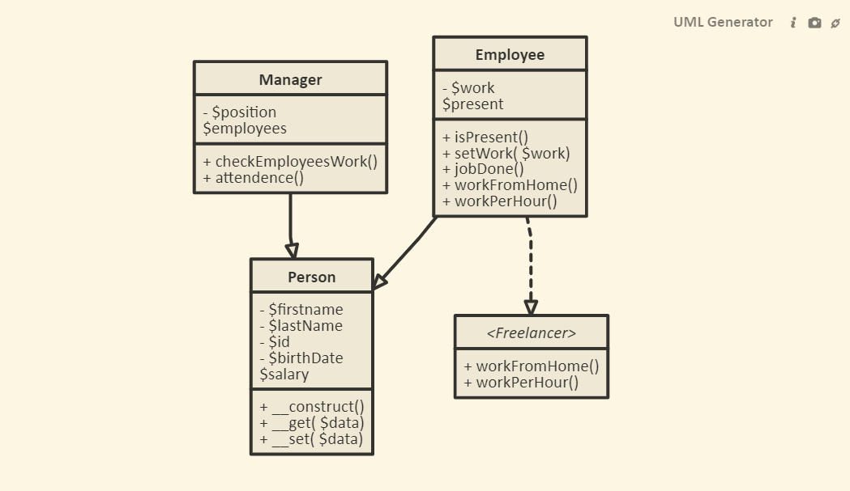
Download Image
Share UML

Slide 10
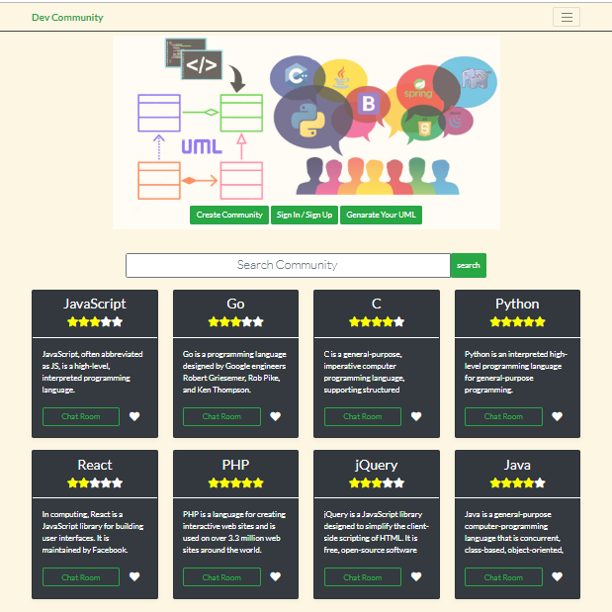
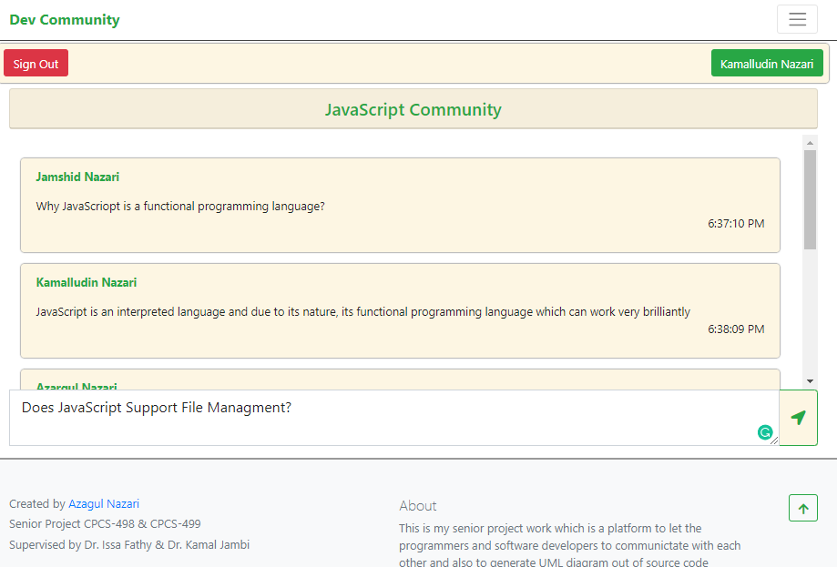
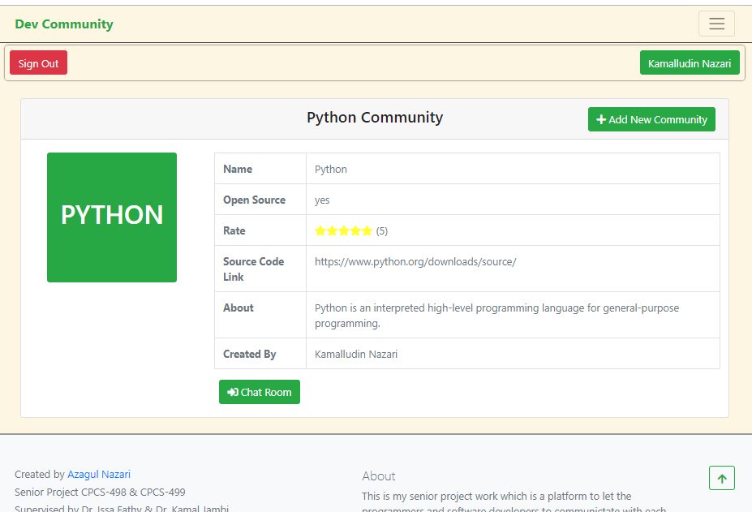

Slide 11




It’s a platform that allows plugins
C# OOP parser
UML
Generator
Python OOP parser
Java OOP parser

Slide 12
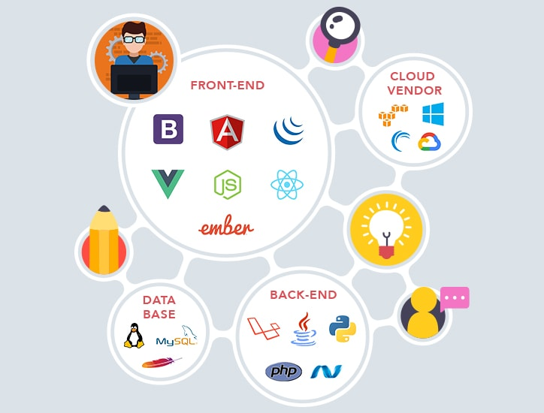
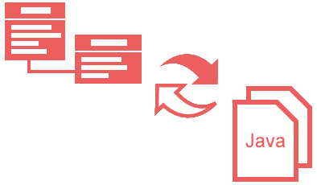
Target Users
Developers
Anyone

Slide 13
Tools
PHP
MySQL
JavaScript
jQuery
…..
MySQL
HTML
CSS
Bootstrap

Slide 14


Special Thanks to
Prof. Isa Fathy
Prof. Kamal Jambi
Supervisor for this project
Co-supervisor for this project

Slide 15
Thank You

